Slide 1
Event Handling
Unit III

Slide 2
javax
Originally, everything that was part of the standard API was part of the java package, whereas everything that was not part of the standard API was released under the package name javax. Hence, packages essential to the API was java, while javax contained the extensions to the API. It can even be said that javax, is just java with an x, which stands for extension.
Over time the extensions that were released as javax, become integral to the Java API. However, moving the extension from the javax package to the java package would be too cumbersome and would end up breaking a bunch of existing code. Hence, eventually it was decided that the javax packages would become part of the standard API.
So, practically there is no difference between Java and Javax. It is all in a name.

Slide 3
Why is Swing Called Swing?
The story is: The team went to Hobees for lunch, and the topic turned to what to name the new toolkit we were writing. Up till then the name was code named KFC, which was chosen by our manager (Rick Levenson) as a way to ensure we'd come with with a better name before shipping; he knew there was no way "KFC", aka Kentucky Fried Chicken, would be allowed by the lawyers.
Some names that were tossed around included Juliet and Carousel. There were many more, but none felt "just right."
Finally after lunch, while driving back to Sun, Amy Fowler (lead engineer of the team) asked our most hip team member, Georges Saab, "Georges, you know what's up and coming... what's the new happening thing in San Francisco?"
Georges responded with "Swing dancing is getting to be really big." And that was it, we all knew it was perfect. When we got back to the office I did a global search and replace of "kfc" with "swing", and the rest is history.

Slide 4
Event Handling
Any program that uses GUI (graphical user interface) such as Java application written for windows, is event driven.
Event describes the change of state of any object.
Events are generated as result of user interaction with the graphical user interface components.

Slide 5
Changing the state of an object is known as an event.
For example: clicking on a button, Entering a character in Textbox, moving the mouse, selecting an item from list, scrolling the page, etc.
The java.awt.event package provides many event classes and Listener interfaces for event handling.

Slide 6
Delegation Event Model
The modern approach to handling events is based on the delegation event model.
The delegation event model provides a standard mechanism for a source to generate an event and send it to a set of listeners.

Slide 7
Delegation Event Model
Its concept is quite simple: a source generates an event and sends it to one or more listeners.
In this scheme, the listener simply waits until it receives an event. Once received, the listener processes the event and then returns.
The advantage of this design is that the application logic that processes events is cleanly separated from the user interface logic that generates those events.
A user interface element is able to “delegate” the processing of an event to a separate piece of code.

Slide 9
In the delegation event model, listener must register with a source in order to receive an event notification.
Notification are sent only to listeners that want to receive them.
There are mainly three parts in delegation event model.
  Events.
  Event sources.
  Event Listeners.

Slide 10
Components of Event Handling
Events
An event is a change of state of an object.
It can be generated as a consequence of a person interacting with the elements in a graphical user interface.
Some of the activities that cause events to be generated are pressing a button, entering a character via the keyboard, selecting an item in a list, and clicking the mouse.

Slide 11
Event
  Events may also occur that are not directly caused by interactions with a user interface.
  For example, an event may be generated when a timer expires, a counter exceeds a value, software or hardware failure occurs, or an operation is completed.
We are free to define events that are appropriate for an application.

Slide 12
Event Sources
A source is an object that generates an event. This occurs when the internal state of that object changes in some way.
Sources may generate more than one type of event.
A source must register listeners in order for the listeners to receive notifications about a specific type of event.
Each type of event has its own registration method.

Slide 13
Here is the general form to register listeners:
  public void addTypeListener(TypeListener el)
  For example: b.addActionListener(this);
Here, type is the name of the event, and el is a reference to the event listener.
For example, the method that registers a keyboard event listener is called addKeyListener().
The method that registers a mouse motion listener is called addMouseMotionListener().
When an event occurs, all registered listeners are notified and receive a copy of the event object.

Slide 14
The general form of unregister listener method is this:
  Public void removeTypeListener(TypeListener el)
Here, type is an object that is notified when an event listener. For example, to remove a keyboard listener, you would call removeKeyListener()

Slide 15
Event Listeners
A listener is an object that is notified when an event occurs.
It has two major requirements. First, it must have been registered with one or more sources to receive notifications about specific types of events.
Second, it must implement methods to receive and process these notifications.
The method that receive and process events are defined in a set of interfaces found in java.awt.event.

Slide 16
Event Listeners
For example, the MouseMotionListener interface defines two methods to receive notifications when the mouse is dragged or moved.
Any object may receive and process one or both of these events if it provides an implementation of this interface.

Slide 17
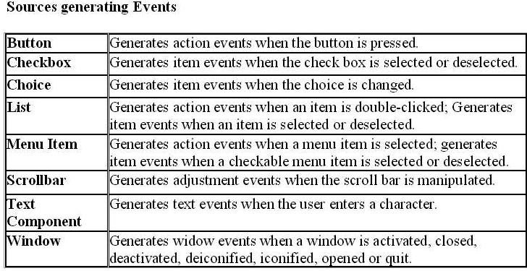

Slide 18
Important Event Classes and Interface

Slide 19
Event Classes
The classes that represent events are at the core of Java’s event handling mechanism.
At the root of the Java event class hierarchy is EventObject, which is in java.util. It is the superclass for all events. EventObject contains two methods: getSource( ) and toString( ).
The getSource( ) method returns the source of the event. Its general form is shown here:
Object getSource( )
As expected, toString( ) returns the string equivalent of the event.

Slide 20
Event Classes
The class AWTEvent, defined within the java.awt package, is a subclass of EventObject.
It is the superclass (either directly or indirectly) of all AWT-based events used by the delegation event model.
  EventObject is a superclass of all events.
  AWTEvent is a superclass of all AWT events that are handled by the delegation event model

Slide 21
Event Classes | Description | Listener Interface
ActionEvent | generated when button is pressed, menu-item is selected, list-item is double clicked | ActionListener
MouseEvent | generated when mouse is dragged, moved, clicked, pressed or released and also when it enters or exit a component | MouseListener
KeyEvent | generated when input is received from keyboard | KeyListener
ItemEvent | generated when check-box or list item is clicked | ItemListener
TextEvent | generated when value of textarea or textfield is changed | TextListener
MouseWheelEvent | generated when mouse wheel is moved | MouseWheelListener
WindowEvent | generated when window is activated, deactivated, deiconified, iconified, opened or closed | WindowListener
ComponentEvent | generated when component is hidden, moved, resized or set visible | ComponentEventListener
ContainerEvent | generated when component is added or removed from container | ContainerListener
AdjustmentEvent | generated when scroll bar is manipulated | AdjustmentListener
FocusEvent | generated when component gains or loses keyboard focus | FocusListener

Slide 22
Steps to handle events:
  Implement appropriate interface in the class.
  Register the component with the listener.

Slide 23
Registration Methods
For registering the component with the Listener, many classes provide the registration methods. For example:
Button
  public void addActionListener(ActionListener a){}
MenuItem
  public void addActionListener(ActionListener a){}
TextField
  public void addActionListener(ActionListener a){}
  public void addTextListener(TextListener a){}
TextArea
  public void addTextListener(TextListener a){}
Checkbox
  public void addItemListener(ItemListener a){}
Choice
  public void addItemListener(ItemListener a){}
List
  public void addActionListener(ActionListener a){}
  public void addItemListener(ItemListener a){}

Slide 24
ActionEvent
An ActionEvent is generated when a button is pressed, a list item is double-clicked, or a menu item is selected.
The ActionEvent class defines four integer constants that are used to identify modifiers associated with an action event:
public static final int ALT_MASK The alt modifier.
  An indicator that the alt key was held down during the event.
public static final int SHIFT_MASK The shift modifier.
  An indicator that the shift key was held down during the event.
public static final int CTRL_MASK The control modifier.
  An indicator that control key was held down during the event.
public static final int META_MASK The meta modifier.
  An indicator that the meta key was held down during the event. (The Meta key is a modifier key on certain keyboards)

Slide 25
Constructor-1
public ActionEvent(Object source,int id,String command,int modifiers)
  Constructs an ActionEvent object with modifier keys.
  Parameters: source - the object that originated the event
  id - an integer that identifies the event
  command - a string that may specify a command (possibly one of several) associated with the event
  modifiers - the modifier keys held down during this action

Slide 26
Constructor-2
public ActionEvent(Object source,int id,String command,long when, int modifiers)
  Constructs an ActionEvent object with the specified modifier keys and timestamp.
  Parameters: source - the object that originated the event
  id - an integer that identifies the event
  command - a string that may specify a command (possibly one of several) associated with the event
  when - the time the event occurred
  modifiers - the modifier keys held down during this action

Slide 27
Methods
public String getActionCommand()
  Returns the command string associated with this action.
public long getWhen()
  Returns the timestamp of when this event occurred.
int getModifiers()
  Returns the modifier keys held down during this action event.
String paramString()
  Returns a parameter string identifying this action event.

Slide 28
ActionListener Interface
This interface defines the actionPerformed() method that is invoked when an action event occurs.
Its general form is shown here:
  void actionPerformed(ActionEvent ae)

Slide 29
import java.applet.*;
import java.awt.*;
import java.awt.event.*;
/* <applet code="ActionEventExample" width=200 height=200>
</applet> */
public class ActionEventExample extends Applet implements ActionListener
{
String actionMessage="";
public void init()
{
Button Button1 = new Button("Ok");
Button Button2 = new Button("Cancel");
add(Button1);
add(Button2);
Button1.addActionListener(this); //Listener Registered
Button2.addActionListener(this); //Listener Registered
}

Slide 30
public void paint(Graphics g)
{
g.drawString(actionMessage,10,50);
}
public void actionPerformed(ActionEvent ae)
{
String action = ae.getActionCommand();
if(action.equals("Ok"))
actionMessage = "Ok Button Pressed";
else if(action.equals("Cancel"))
actionMessage = "Cancel Button Pressed";
repaint();
}
}

Slide 31
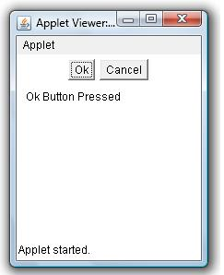

Slide 32
ComponentEvent class
A low-level event which indicates that a component moved, changed size, or changed visibility.
This class has following constants.
public static final int COMPONENT_MOVED
  This event indicates that the component's position changed.
public static final int COMPONENT_RESIZED
  This event indicates that the component's size changed.
public static final int COMPONENT_SHOWN
  This event indicates that the component was made visible.
public static final int COMPONENT_HIDDEN
  This event indicates that the component was become invisible.

Slide 33
public ComponentEvent(Component source, int id)
  Constructs a ComponentEvent object.
  Parameters:
  source - the Component that originated the event
  id - an integer indicating the type of event
Component getComponent()
  Returns the creator of the event.
  the Component object that originated the event, or null if the object is not a Component.

Slide 34
ComponentLIstener interface
The listener interface for receiving component events.
void componentResized(ComponentEvent e)
  Invoked when the component's size changes.
void componentMoved(ComponentEvent e)
  Invoked when the component's position changes
void componentShown(ComponentEvent e)
  Invoked when the component has been made visible.
void componentHidden(ComponentEvent e)
  Invoked when the component has been made invisible.

Slide 35
import java.awt.*;
import java.awt.event.*;
import javax.swing.*;
public class ComponentEventExample1
{
public static void main(String[] args)
{
JFrame frame = new JFrame("ComponentEventExample");
frame.setDefaultCloseOperation(JFrame.EXIT_ON_CLOSE);
TextArea txtArea = new TextArea();
Checkbox checkbox1 = new Checkbox("Checkbox 1");
Checkbox checkbox2 = new Checkbox("Checkbox 2");
frame.add(txtArea, BorderLayout.CENTER);
frame.add(checkbox1, BorderLayout.NORTH);
frame.add(checkbox2, BorderLayout.SOUTH);
frame.setVisible(true);
ComponentListener componentListener = new MyCompList();
frame.addComponentListener(componentListener);
}
}

Slide 36
class MyCompList implements ComponentListener
{
public void componentShown(ComponentEvent evt)
{
System.out.println("componentShown");
}
public void componentHidden(ComponentEvent evt)
{
System.out.println("componentHidden");
}
public void componentMoved(ComponentEvent evt)
{
System.out.println("componentMoved");
}
public void componentResized(ComponentEvent evt)
{
System.out.println("componentResized");
}
}

Slide 37
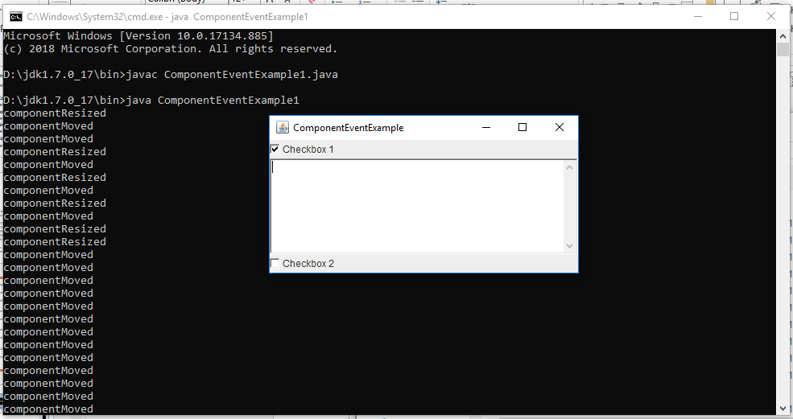
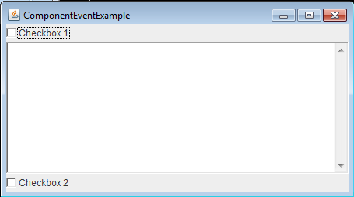

Slide 38
ContainerEvent class
A low-level event which indicates that a container's contents changed because a component was added or removed
This class has following constants.
public static final int COMPONENT_ADDED
  This event indicates that a component was added to the container.
public static final int COMPONENT_REMOVED
  This event indicates that a component was removed from the container.

Slide 39
public ContainerEvent(Component source, int id, Component child)
  Constructs a ContainerEvent object.
  Parameters:
  source - the Component object (container) that originated the event
  id - an integer indicating the type of event
  child - the component that was added or removed

Slide 40
public Container getContainer()
  Returns the originator of the event.
  Returns the Container object that originated the event, or null if the object is not a Container.
public Component getChild()
  Returns the component that was affected by the event.
  Returns the Component object that was added or removed.

Slide 41
ContainerListener interface
  The listener interface for receiving container events.
void componentAdded(ContainerEvent e)
  Invoked when a component has been added to the container.
void componentRemoved (ContainerEvent e)
  Invoked when a component has been removed from the container.

Slide 42
import java.awt.*;
import java.awt.event.*;
import javax.swing.*;
public class ContainerEventExample
{
public static void main(String args[])
{
JFrame frame = new JFrame();
frame.setDefaultCloseOperation(JFrame.EXIT_ON_CLOSE);
Container contentPane = frame.getContentPane();
ContainerListener cont = new ContainerListener()
{
ActionListener listener = new ActionListener()
{
public void actionPerformed(ActionEvent e)
{
System.out.println("Selected: " + e.getActionCommand());
}
};

Slide 43
public void componentAdded(ContainerEvent e)
{
Component c = e.getChild();
if (c instanceof JButton)
{
JButton b = (JButton) c;
b.addActionListener(listener);
}
}
public void componentRemoved(ContainerEvent e)
{
Component c = e.getChild();
if (c instanceof JButton)
{
JButton b = (JButton) c;
b.removeActionListener(listener);
}
}
};

Slide 44
contentPane.addContainerListener(cont);
contentPane.setLayout(new GridLayout(3, 2));
contentPane.add(new JButton("First"));
contentPane.add(new JButton("Second"));
contentPane.add(new JButton("Third"));
contentPane.add(new JButton("Fourth"));
contentPane.add(new JButton("Fifth"));
frame.setSize(300, 200);
frame.show();
}
}

Slide 45
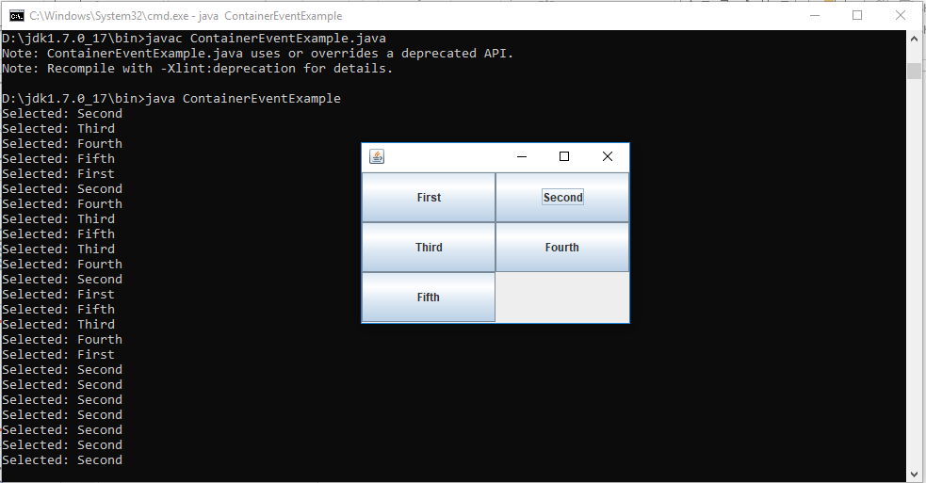

Slide 46
FocusEvent class
A low-level event which indicates that a Component has gained or lost the input focus.
This class has following constants.
public static final int FOCUS_GAINED
  This event indicates that the Component is now the focus owner.
public static final int FOCUS_LOST
  This event indicates that the Component is no longer the focus owner.

Slide 47
Constructors
public FocusEvent(Component source,int id,boolean temporary, Component opposite)
  source - the Component that originated the event
  id - FOCUS_GAINED or FOCUS_LOST
  temporary - true if the focus change is temporary; false otherwise
  opposite - the other Component involved in the focus change, or null

Slide 48
public FocusEvent(Component source,int id,boolean temporary)
  id - an integer indicating the type of event
  temporary - true if the focus change is temporary; false otherwise.
public FocusEvent(Component source,int id)
  source - the Component that originated the event
  id - an integer indicating the type of event

Slide 49
Methods
public boolean isTemporary()
  Identifies the focus change event as temporary or permanent.
  Returns: true if the focus change is temporary; false otherwise
public Component getOppositeComponent()
  Returns the other Component involved in this focus change.

Slide 50
FocusListener interface
void focusGained(FocusEvent e)
  Invoked when a component gains the keyboard focus.
void focusLost(FocusEvent e)
  Invoked when a component loses the keyboard focus.

Slide 51
import java.awt.*;
import java.awt.event.*;
import javax.swing.*;
public class FocusListenerExample extends JFrame implements FocusListener
{
Button b1,b2;
public FocusListenerExample()
{
b1=new Button ("First");
b2=new Button ("Second");
add(b1,BorderLayout.SOUTH);
add(b2,BorderLayout.NORTH);
b1.addFocusListener(this);
b2.addFocusListener(this);
setSize(200,200);
setDefaultCloseOperation(JFrame.EXIT_ON_CLOSE);
setVisible(true);
}

Slide 52
public void focusGained(FocusEvent fe) //method of focuslistener
{
if(fe.getSource()==b1)
System.out.println(b1.getLabel()+"gained");
if(fe.getSource()==b2)
System.out.println(b2.getLabel()+"gained");
if(fe.isTemporary())
System.out.println("Temporary Focus");
}
public void focusLost(FocusEvent fe) //in focusevent "getID()"is a method
{
if(fe.getSource()==b1)
System.out.println(b1.getLabel()+"lost");
if(fe.getSource()==b2)
System.out.println(b2.getLabel()+"lost");
}
public static void main(String a[])
{
new FocusListenerExample();
}
}

Slide 53
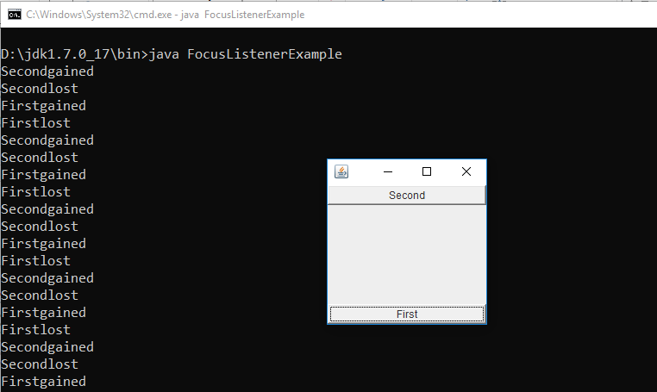

Slide 54
ItemEvent class
A semantic event which indicates that an item was selected or deselected.
This high-level event is generated by an ItemSelectable object (such as a List) when an item is selected or deselected by the user.
This class has following constants.
public static final int SELECTED
  This state-change value indicates that an item was selected.
public static final int DESELECTED
  This state-change-value indicates that a selected item was deselected

Slide 55
public ItemEvent (ItemSelectable source, int id, Object item, int stateChange)
  Constructs an ItemEvent object.
  Parameters:
  source - the ItemSelectable object that originated the event
  id - an integer that identifies the event type
  item - an object -- the item affected by the event
  stateChange - an integer that indicates whether the item was selected or deselected

Slide 56
Methods of ItemEvent Class
public ItemSelectable getItemSelectable()
  Returns the creator of the event.
  Returns: the ItemSelectable object that originated the event.
public Object getItem()
  Returns the item affected by the event.
  Returns: the item (object) that was affected by the event.
public int getStateChange()
  Returns the type of state change (selected or deselected).
  Returns: an integer that indicates whether the item was selected or deselected

Slide 57
ItemListener interface
The listener interface for receiving item events.
void itemStateChanged(ItemEvent e)
Invoked when an item has been selected or deselected by the user.
The code written for this method performs the operations that need to occur when an item is selected (or deselected).

Slide 58
import java.applet.*;
import java.awt.*;
import java.awt.event.*;
/* <applet code="ItemListenerExample" width=200 height=200>
</applet> */
public class ItemListenerExample extends Applet implements ItemListener
{
Checkbox java = null;
Checkbox vb = null;
Checkbox c = null;

Slide 59
public void init()
{
java = new Checkbox("Java");
vb = new Checkbox("Visual Basic");
c = new Checkbox("C");
add(java);
add(vb);
add(c);
java.addItemListener(this);
vb.addItemListener(this);
c.addItemListener(this);
}
public void paint(Graphics g)
{
g.drawString("Java: " + java.getState(),10,80);
g.drawString("VB: " + vb.getState(), 10, 100);
g.drawString("C: " + c.getState(), 10, 120);
}
public void itemStateChanged(ItemEvent ie)
{
repaint();
}
}

Slide 60
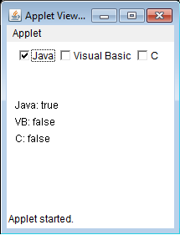

Slide 61
KeyEvent class
An event which indicates that a keystroke occurred in a component.
This class has following constant.
public static final int KEY_PRESSED
  This event is generated when a key is pushed down.
public static final int KEY_RELEASED
  This event is generated when a key is let up.
public static final int KEY_TYPED
  This event is generated when a character is entered. In the simplest case, it is produced by a single key press. Often, however, characters are produced by series of key presses, and the mapping from key pressed events to key typed events may be many-to-one or many-to-many.

Slide 62
There are many other integer constants that are defined by KeyEvent. For example
  VK_0 to VK_9
  VK_A to VK_Z define the ASCII equivalents of the numbers and letters.
Here are some others:
  VK_ENTER, VK_ESCAPE, VK_CANCEL, VK_UP, VK_DOWN, VK_LEFT, VK_RIGHT, VK_PAGE_DOWN,VK_PAGE_UP, VK_SHIFT, VK_ALT, VK_CONTROL
The VK constants specify virtual key codes and are independent of any modifiers, such as control, shift, or alt.

Slide 63
Methods of KeyEvent class
public int getKeyCode()
  Returns the integer keyCode associated with the key in this event.
  Returns: the integer code for an actual key on the keyboard.
public char getKeyChar()
  Returns the character associated with the key in this event.
  For example, the KEY_TYPED event for shift + "a" returns the value for "A".
  boolean isActionKey()
  Returns true if the key firing the event is an action key. Examples of action keys include Page Up, Caps Lock, the arrow and function keys.

Slide 64
KeyListener Interface
Key events indicate when the user is typing at the keyboard.
Key events are fired by the component with the keyboard focus when the user presses or releases keyboard keys.
Notifications are sent about two basic kinds of key events:
  The typing of a Unicode character
  The pressing or releasing of a key on the keyboard

Slide 65
The first kind of event is called a key-typed event.
  To know when the user types a Unicode character ? whether by pressing one key such as 'a' or by pressing several keys in sequence ?
The second kind is either a key-pressed or key-released event.
  To know when the user presses the F1 key, or whether the user pressed the '3' key on the number pad, you handle key-pressed events.

Slide 66
Methods of KeyListener Interface
Method | Purpose
keyTyped(KeyEvent) | Called just after the user types a Unicode character into the listened-to component.
keyPressed(KeyEvent) | Called just after the user presses a key while the listened-to component has the focus.
keyReleased(KeyEvent) | Called just after the user releases a key while the listened-to component has the focus.

Slide 67
import java.awt.*;
import java.awt.event.*;
import javax.swing.JApplet;
public class EventDemo6 extends JApplet implements KeyListener
{
String event; // description of keyboard event
public void init() // set up UI
{
setLayout(new FlowLayout());
event = ""; addKeyListener(this); // listen for keyboard events
setFocusable(true); // force applet to receive KeyEvent
}
public void paint(Graphics g) // draw message to applet
{
super.paint(g);
g.drawRect(0, 0, getWidth(), getHeight()); // show bounds of applet
g.drawString(event, 10, 50);
}

Slide 68
public void keyPressed(KeyEvent e) // handle key presses
{
event = e.getKeyChar() + " pressed"; repaint();
}
public void keyReleased(KeyEvent e) // handle key releases
{
event = e.getKeyChar() + " released"; repaint();
}
public void keyTyped(KeyEvent e) // handle typing on applet
{
event = e.getKeyChar() + " typed"; repaint();
}
}

Slide 69
TextEvent class
A semantic event which indicates that an object's text changed.
This high-level event is generated by an object (such as a TextComponent) when its text changes.
public TextEvent(Object source,int id)
  Constructs a TextEvent object.
  Parameters:
  source - the (TextComponent) object that originated the event
  id - an integer that identifies the event type

Slide 70
TextListener interface
The listener interface for receiving text events.
void textValueChanged(TextEvent e)
Invoked when the value of the text has changed.
The code written for this method performs the operations that need to occur when text changes.

Slide 71
WindowEvent class
A low-level event indicates that a window has changed its status.
This event is generated by a Window object when it is opened, closed, activated, deactivated, iconified, or deiconified, or when focus is transferred into or out of the Window.

Slide 72
int constants
WINDOW_ACTIVATED
WINDOW_CLOSED
WINDOW_CLOSING
WINDOW_DEACTIVATED
WINDOW_DEICONIFIED
WINDOW_GAINED_FOCUS
WINDOW_ICONIFIED
WINDOW_LOST_FOCUS
WINDOW_OPENED
WINDOW_STATE_CHANGED

Slide 73
Constructors
public WindowEvent(Window source,int id)
  Constructs a WindowEvent object.
  Parameters: source - the Window object that originated the event
  id - an integer indicating the type of event
- public WindowEvent(Window source,int id,Window opposite,int oldState, int newState)
  Note that passing in an invalid id results in unspecified behavior. This method throws an IllegalArgumentException if source is null.
  source - the Window object that originated the event
  id - an integer indicating the type of event.
  opposite - the other window involved in the focus or activation change, or null
  oldState - previous state of the window for window state change event
  newState - new state of the window for window state change event

Slide 74
public Window getWindow()
  Returns the originator of the event.
  Returns: the Window object that originated the event

Slide 75
WindowListener interface
void windowOpened(WindowEvent e)
  Invoked the first time a window is made visible.
void windowClosing(WindowEvent e)
  Invoked when the user attempts to close the window from the window's system menu.
void windowClosed(WindowEvent e)
  Invoked when a window has been closed as the result of calling dispose on the window
void windowIconified(WindowEvent e)
  Invoked when a window is changed from a normal to a minimized state. For many platforms, a minimized window is displayed as the icon specified in the window's iconImage property.
void windowDeiconified(WindowEvent e)
  Invoked when a window is changed from a minimized to a normal state.
void windowActivated(WindowEvent e)
  Invoked when the Window is set to be the active Window.
void windowDeactivated(WindowEvent e)
  Invoked when a Window is no longer the active Window.

Slide 76
WindowFocusListener interface
The listener interface for receiving WindowEvents, including WINDOW_GAINED_FOCUS and WINDOW_LOST_FOCUS events.
void windowGainedFocus(WindowEvent e)
  Invoked when the Window is set to be the focused Window, which means that the Window, or one of its subcomponents, will receive keyboard events.
void windowLostFocus(WindowEvent e)
  Invoked when the Window is no longer the focused Window, which means that keyboard events will no longer be delivered to the Window or any of its subcomponents.

Slide 77
MouseEvent class
This event indicates a mouse action occurred in a component. This low-level event is generated by a component object for Mouse Events and Mouse motion events.

Slide 78
Constants for java.awt.event.MouseEvent class:
static int BUTTON1 --Indicates mouse button #1; used by getButton()
static int BUTTON2 --Indicates mouse button #2; used by getButton()
static int BUTTON3 --Indicates mouse button #3; used by getButton()
static int MOUSE_CLICKED --The "mouse clicked" event
static int MOUSE_DRAGGED --The "mouse dragged" event
static int MOUSE_ENTERED --The "mouse entered" event
static int MOUSE_EXITED --The "mouse exited" event
static int MOUSE_MOVED --The "mouse moved" event
static int MOUSE_PRESSED -- The "mouse pressed" event
static int MOUSE_RELEASED --The "mouse released" event
static int MOUSE_WHEEL --The "mouse wheel" event

Slide 79
Constructor
MouseEvent(Component source, int id, long when, int modifiers, int x, int y, int clickCount, boolean popupTrigger)
  Constructs a MouseEvent object with the specified
  source- source component,
  id- type of event,
  when- system time at mouse event occurred
  modifiers-to know what modifiers were pressed after event was occurred,
  x & y- coordinates of the mouse ,
  clickCount- click count
  popupTrigger- whether popup menu appeared

Slide 80
Method | Purpose
int getClickCount() | Returns the number of quick, consecutive clicks the user has made (including this event). For example, returns 2 for a double click.
int getButton() | Returns which mouse button, if any, has a changed state. One of the following constants is returned: NOBUTTON, BUTTON1, BUTTON2, or BUTTON3.
int getX() int getY() | Return the (x,y) position at which the event occurred, relative to the component that fired the event.
Point getPoint() | Returns the x,y position of the event rlative to the source component.

Slide 81
MouseListener Interface
Mouse events notify when the user uses the mouse (or similar input device) to interact with a component.
Mouse events occur when the cursor enters or exits a component's onscreen area and when the user presses or releases one of the mouse buttons.

Slide 82
Methods of MouseListener Interface
Method | Purpose
mouseClicked(MouseEvent) | Called just after the user clicks the listened-to component.
mouseEntered(MouseEvent) | Called just after the cursor enters the bounds of the listened-to component.
mouseExited(MouseEvent) | Called just after the cursor exits the bounds of the listened-to component.
mousePressed(MouseEvent) | Called just after the user presses a mouse button while the cursor is over the listened-to component.
mouseReleased(MouseEvent) | Called just after the user releases a mouse button after a mouse press over the listened-to component.

Slide 83
MouseMotionListener Interface
Mouse-motion events notify when the user uses the mouse (or a similar input device) to move the onscreen cursor.
If an application requires the detection of both mouse events and mouse-motion events, use the MouseInputAdapter class.
It implements the MouseInputListener a convenient interface that implements both the MouseListener and MouseMotionListener interfaces.

Slide 84
Methods of MouseMotionListener Interface
Method | Purpose
mouseDragged(MouseEvent) | Called in response to the user moving the mouse while holding a mouse button down. This event is fired by the component that fired the most recent mouse-pressed event, even if the cursor is no longer over that component.
mouseMoved(MouseEvent) | Called in response to the user moving the mouse with no mouse buttons pressed. This event is fired by the component that's currently under the cursor.

Slide 85
import java.awt.*;
import java.awt.event.*;
import javax.swing.*;
public class MouseEventDemo extends JApplet implements MouseListener
{
private int x; // x coordinate of mouse event
private int y; // y coordinate of mouse event
private String event; // description of mouse event
public void init() // set up GUI
{
setLayout(new FlowLayout());
addMouseListener(this); // listen for mouse events
x = -1; // set x negative for no initial message
}

Slide 86
public void paint(Graphics g) // draw message to screen
{
super.paint(g);
g.drawRect(0, 0, getWidth(), getHeight()); // show bounds of applet
if(x != - 1) // display event during repainting only
{
g.drawString("Mouse event " + event +
" at (" + x + ", " + y + ")",
10, 50);
}
}
public void mousePressed(MouseEvent e) // save coordinates of presses
{
x = e.getX();
y = e.getY();
event = "press";
repaint();
}

Slide 87
public void mouseClicked(MouseEvent e) // save coordinates of clicks
{
x = e.getX();
y = e.getY();
event = "click";
repaint();
}
public void mouseReleased(MouseEvent e) // save coordinates of releases
{
x = e.getX();
y = e.getY();
event = "release";
repaint();
}

Slide 88
public void mouseEntered(MouseEvent e) // save coordinates when mouse enters applet
{
x = e.getX();
y = e.getY();
event = "enter";
repaint();
}
public void mouseExited(MouseEvent e) // save coordinates when mouse leaves applet
{
x = e.getX();
y = e.getY();
event = "exit";
repaint();
}
}
/*<applet code=MouseEventDemo height=300 width=300></applet>*/

Slide 89
AdjustmentEvent
An AdjustmentEvent is generated by a scroll bar. There are five types of adjustment events.
The AdjustmentEvent class defines integer constants that can be used to identify them.
BLOCK_DECREMENT
  The user clicked inside the scroll bar to decrease its value.
BLOCK_INCREMENT
  The user clicked inside the scroll bar to increase its value.
TRACK
  The slider was dragged.
UNIT_DECREMENT
  The button at the end of the scroll bar was clicked to decrease its value.
UNIT_INCREMENT
  The button at the end of the scroll bar was clicked to increase its value.

Slide 90
The type of the adjustment event may be obtained by the getAdjustmentType( ) method. It returns one of the constants defined by AdjustmentEvent.
The general form is shown here:
  int getAdjustmentType( )
The amount of the adjustment can be obtained from the getValue( ) method, shown here:
  int getValue( )
For example, when a scroll bar is manipulated, this method returns the value represented by that change.

Slide 91
AdjustmentListener Interface
This interface defines the adjustmentValueChanged( ) method that is invoked when an adjustment event occurs.
Its general form is shown here:
void adjustmentValueChanged(AdjustmentEvent ae)

Slide 92
Summary of Event Classes & Listeners

Slide 93
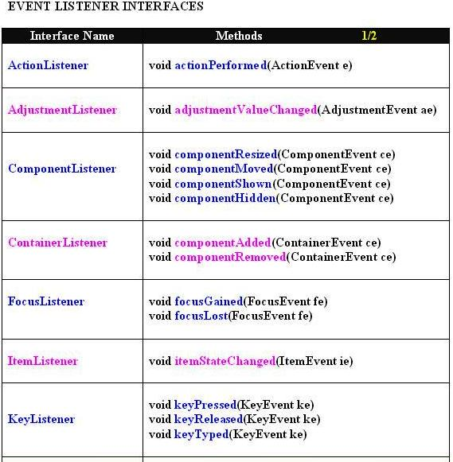

Slide 94
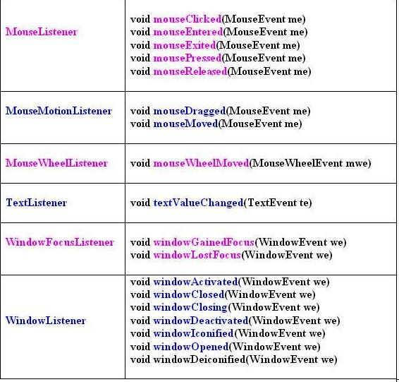

Slide 95
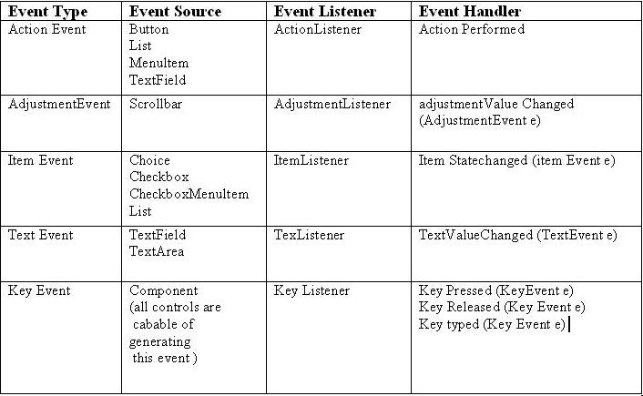

Slide 96
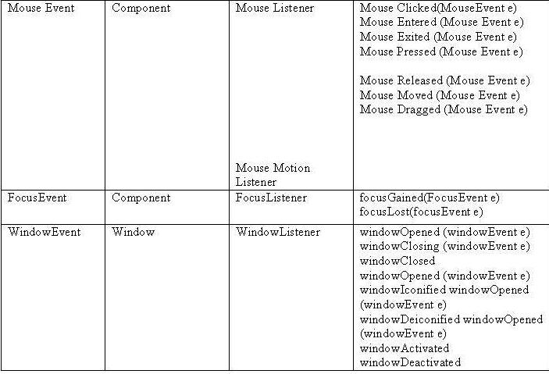

Slide 97
Adapter Classes
Java provides a special feature, called an adapter class that can simplify
the creation of event handlers in certain situations. An adapter class provides
an empty implementation of all methods in an event listener interface. Adapter
classes are useful when we want to receive and process only some of the
events that are handled by a particular event listener interface. We can define a
new class to act as an event listener by extending one of the adapter classes
and implementing only those events in which we are interested. For example,
the MouseMotionAdapter class has two methods, mouseDragged( ) and
mouseMoved( ).

